Slide 1
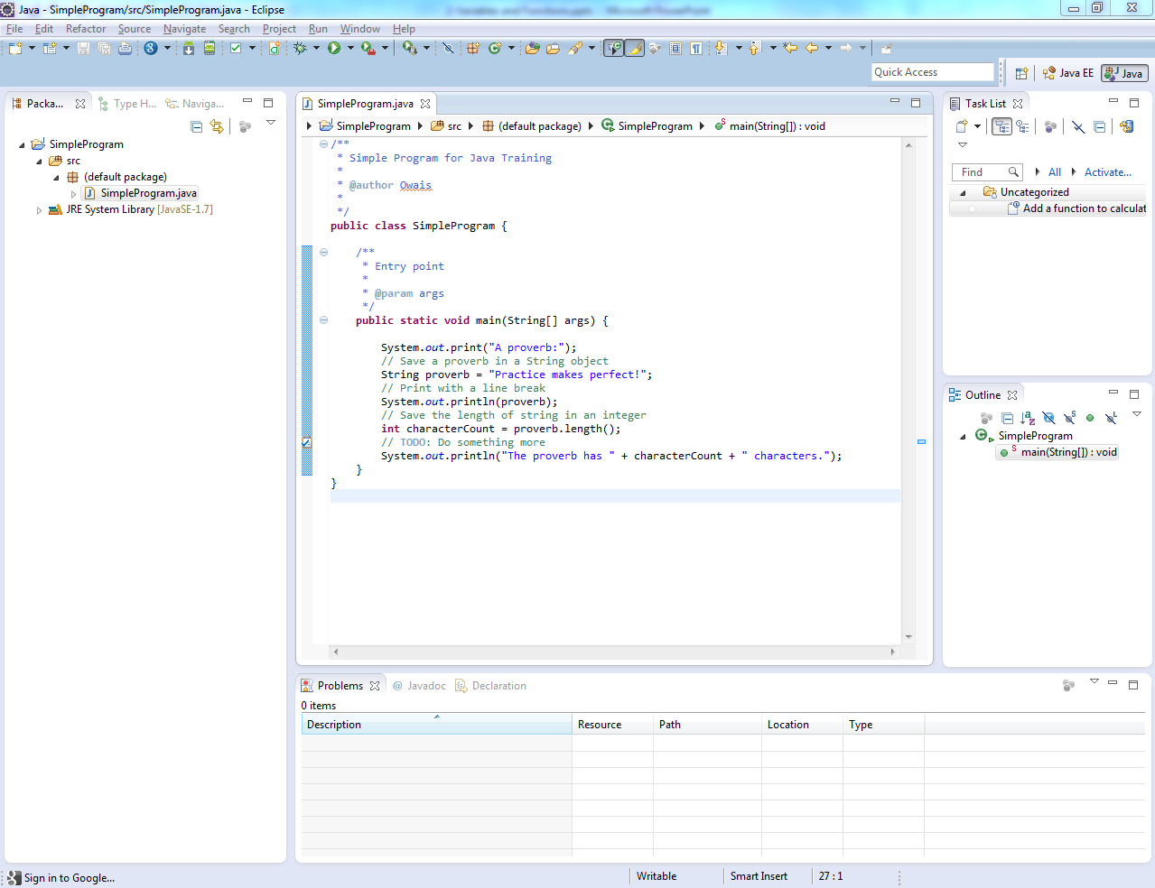

Slide 2
Common Eclipse Operations
Auto Build
Clean
Build
Run/Debug
Perspectives
Java
Java EE
Debug
Notes:
Time: 5

Slide 3
Common Eclipse Operations
Exploring Projects
Package Explorer
Folders (src, lib, bin, test)
Navigating Code
Outline
Breadcrumb
Hierarchies
Commenting Code
Line
Block
TODO
Notes:
Time: 15

Slide 4
Common Eclipse Operations
Quick Fixes
Quick Suggestions
Auto Imports
Refactoring
Code Formatting
Auto Format
Formatting Styles
Notes:
Time: 20

Slide 5
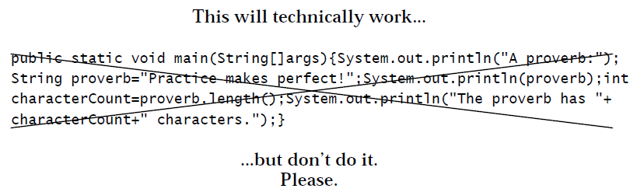
Indentation and Convention
Indentation
Notes:
Image from Slide 14 of “1 Getting Started.pdf”

Slide 6
Indentation and Convention
Camel Case Convention
Classes
WRONG | CORRECT
Patient | Patient
ContactClass | Contact
Lab_Result | LabResult
Drugs | Drug
ABBRMain | AbbrMain
Notes:
Time: 10

Slide 7
Indentation and Convention
Camel Case Convention
Variables/Functions
WRONG | CORRECT
FullName | fullName
date_of_birth | dateOfBirth
adrstrt1 | addressStreet1
speedOfLight = 299792458 | SPEED_OF_LIGHT = 299792458
nICNumber | nicNumber
txtCmnts | commentsTextBox
Notes:
Estimated Time: 1hr

